Slide 1
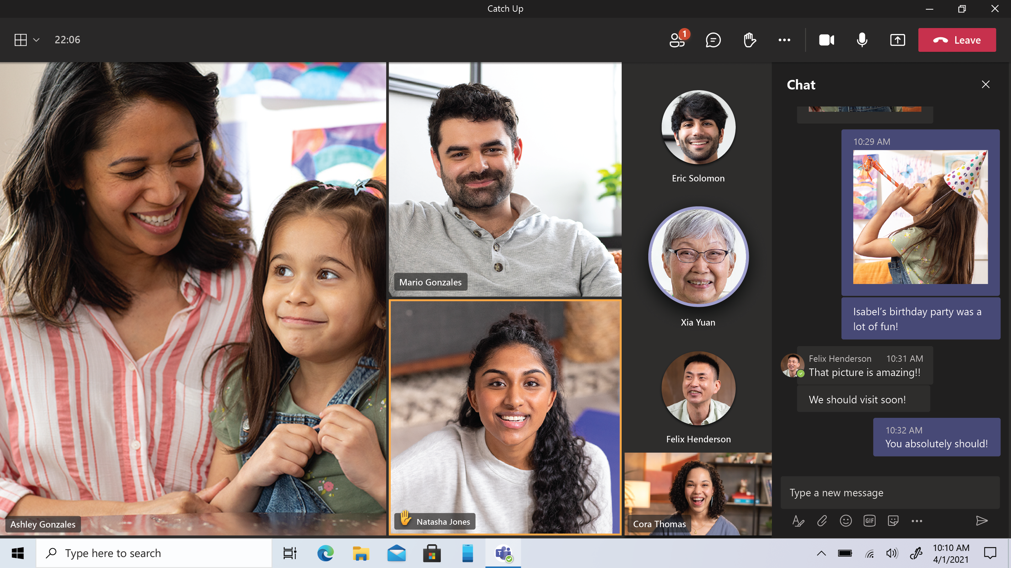
MICROSOFT ENGAGE 2021 MS TEAMS CLONE

Slide 2

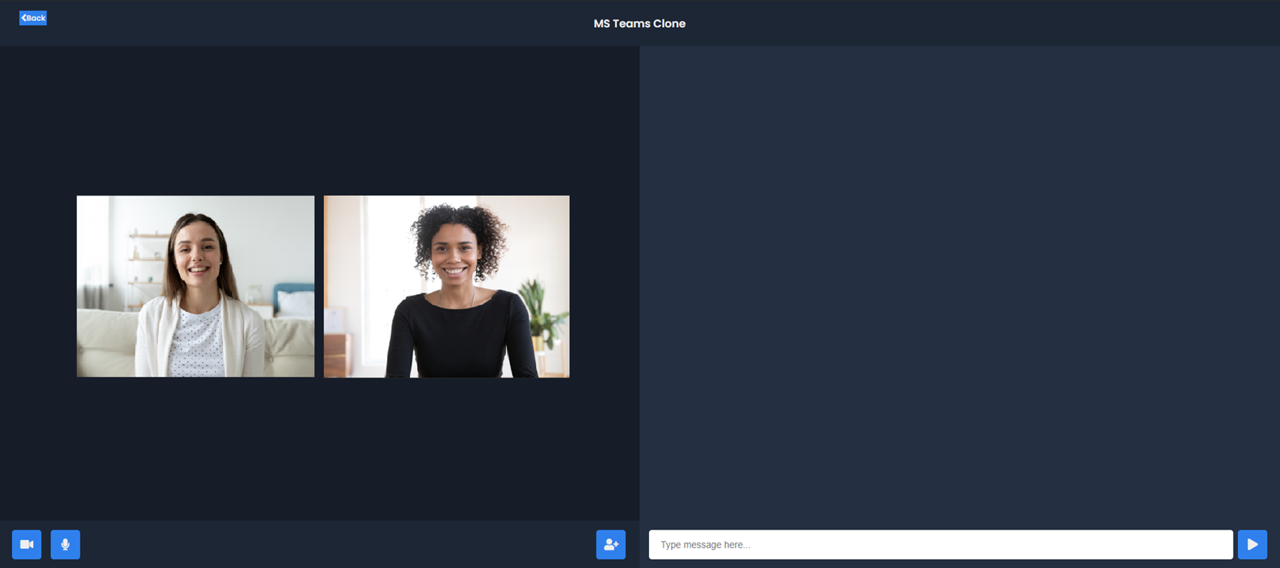
OVERVIEW

Slide 3
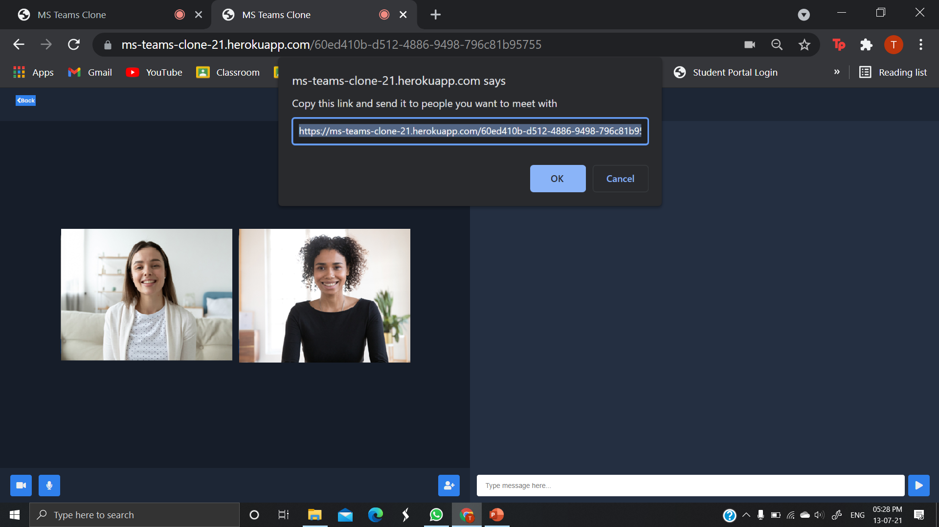
OVERVIEW

Slide 4

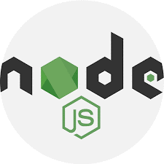
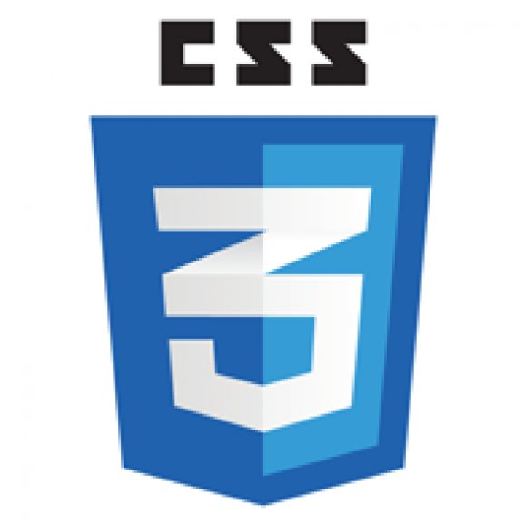

TECHNOLOGIES USED
CSS
HTML
NodeJS

Slide 5
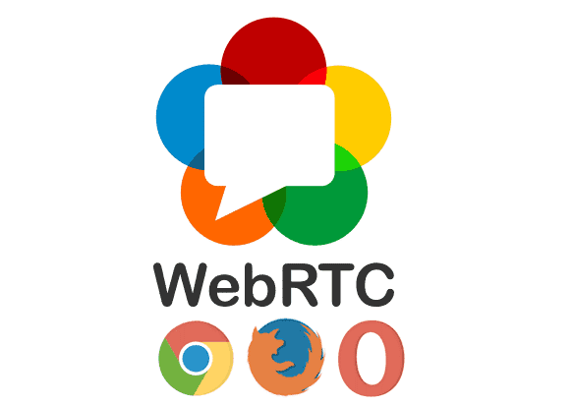
WEBRTC
WebRTC is a free and open-source project providing web browsers and mobile applications with real-time communication via simple application programming interfaces.

Slide 6
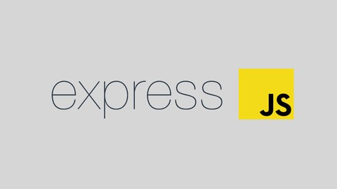
EXPRESS JS
Express.js, or simply Express, is a back end web application framework for Node.js, released as free and open-source. It is designed for building web applications and APIs.

Slide 7

SOCKET.IO
Socket.IO is a JavaScript library for real-time web applications. It enables real-time, bi-directional communication between web clients and servers.

Slide 8
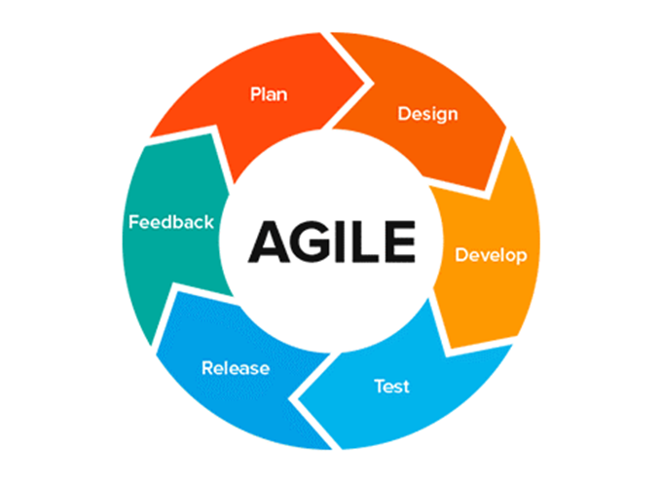
AGILE METHODOLGY
In software development, agile practices involve discovering requirements and developing solutions through the collaborative effort of self-organizing and cross-functional teams and their customers. It advocates adaptive planning, evolutionary development, early delivery, and continual improvement, and it encourages flexible responses to change.

Slide 9




THANK YOU!
Tanishka Singh
tanishkasingh18@outlook.com
Delhi Technological University

